Slide 1
Musings about SOS
Buddy Bland
Presented to:
SOS20 Conference
March 25, 2016
Asheville, NC

Slide 2
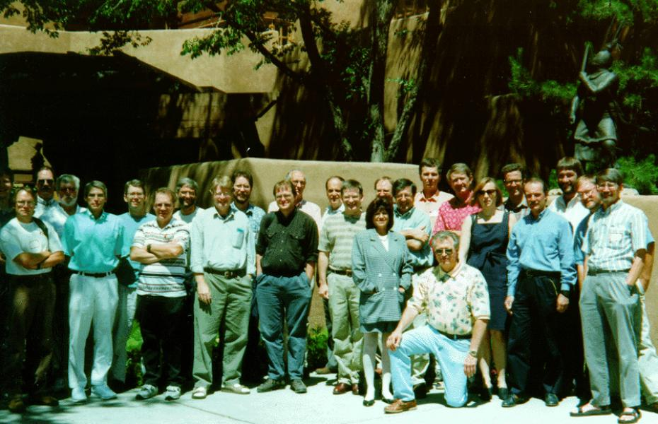
Why SOS?
In 1985, a group of pioneers in parallel processing founded the Intel Supercomputer Users Group
ISUG was an independently run, non-profit organization.
Charter: “To promote the exchange of information among users of Intel scalable supercomputer products and between the users and the Scalable Systems Division of Intel.”
But in 1996, Intel SSD was disbanded and the ISUG dissolved.
In June, 1997, members of the group from Sandia, Oak Ridge, and the Swiss supercompting center kicked of the first SOS conference in Santa Fe.
SOS is about the needs of parallel clusters and MPP systems at scale
SOS 1 June 1997 Santa Fe

Slide 3
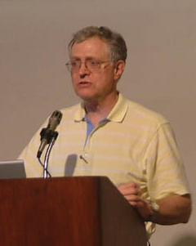
SOS Steering Committee
Bill Camp – Sandia
Neil Pundit – Sandia
Al Geist – ORNL
Ralf Gruber – EPFL
Marie-Christine Sawley – ETHZ
Pierre Kuonen – HEIA-FR
Pictures from SOS10
Notes:
HEIA-FR: University of Applied Sciences in Fribourg Switzerland

Slide 4
List of SOS Conferences
Name | Host | Location | Dates
SOS1 | Sandia | Santa Fe | June 25-27, 1997
SOS2 | ORNL | Charleston | March 30-April 1, 1998
SOS3 | CSCS | Villars | March 22-24, 1999
SOS4 | Sandia | New Orleans | March 9-10, 2000
SOS5 | ORNL | Hyannis | May 23-24, 2001
SOS6 | CSCS | Leukerbad | March 4-6, 2002
SOS7 | Sandia | Durango | March 4-6, 2003
SOS8 | ORNL | Charleston | April 12-14, 2004
SOS9 | CSCS | Davos | March 21-23, 2005
SOS10 | Sandia | Maui | March 6-9, 2006
SOS11 | ORNL | Key West | June 12-14, 2007
SOS12 | CSCS | Wildhaus | March 10-12, 2008
SOS13 | Sandia | Hilton Head | March 9-12, 2009
SOS14 | ORNL | Savannah | March 8-11, 2010
SOS15 | CSCS | Engelberg | March 14-16, 2011
SOS16 | Sandia | Santa Barbara | March 12-15, 2012
SOS17 | ORNL | Jekyll Island | March 25-28, 2013
SOS18 | CSCS | St. Moritz | March 17-20, 2014
SOS19 | Sandia | Park City | March 2-5, 2015
SOS20 | ORNL | Asheville | March 23-25, 2016
SOS 1 June 1997 Santa Fe
Notes:
We have rotated the conference hosts among the three labs
Most of the conferences have been in March

Slide 5
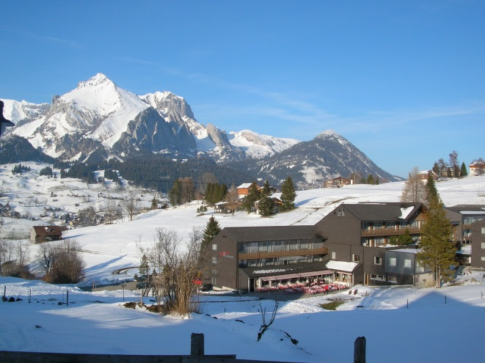
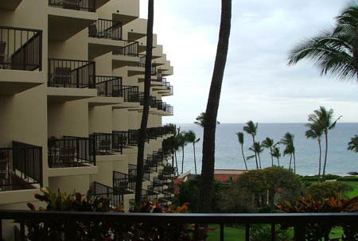
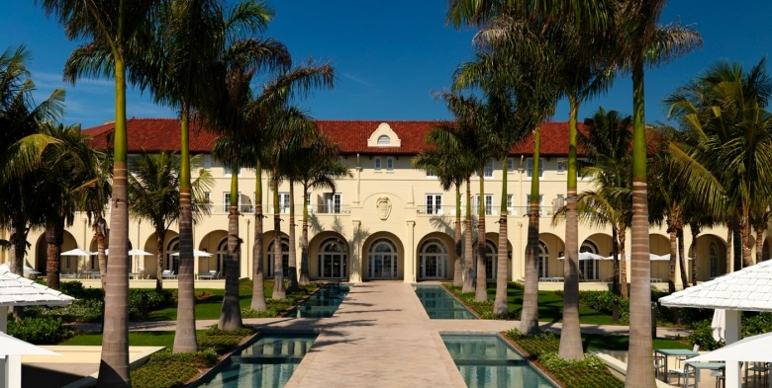
We have been to some beautiful locations!
SOS 7 2003 Durango
SOS 12 2008 Wildhaus
SOS 18 2014 St. Moritz
SOS 10
2006
Maui
SOS 11
2007
Key West

Slide 6
And heard many interesting talks
SOS7 Durango 2003
Notes:
When Thomas Sterling gave the dinner talk in 2003, the #1 system on the Top500 list was the Earth Simulator at 36TF – 5 orders of magnitude from Exaflops!

Slide 7
There have been three tracks for talks
1. Computer Systems and Architecture
We have seen and discussed systems that span Gigaflops, Teraflops, Petaflops, and Exaflops
Vectors, PIMs, SMPs, Clusters, Thin nodes, Fat Nodes, FPGA, Multi-core, SOC, Many-core, Cell, GPUs
Memory bandwidth issues have been a common theme
Power and Cooling constraints

Slide 8
There have been three tracks for talks
2. System Software and Tools
Message passing models (pre-MPI, Portals, PGAS, etc.)
Grid Computing
Operating Systems (LWK, Full OS, Function Shipping)
Runtime systems
I/O issues, File Systems
Data Analytics
Virtualization
Compilers, Debuggers
AMR techniques

Slide 9
There have been three tracks for talks
3. Applications and Performance Tuning
Algorithms
Fault Tolerance
Numerical and I/O Libraries
Parallelism
Data Motion
Workflows

Slide 10
It is interesting to see what we got right and what was a little off
Jaguar – 2008
Sockets: 37,544
Cores: 150,176 (quad)
Memory: 300 TB
Disk Capacity: 10 PB
Disk Bandwidth: 240 GB/s
Interconnect XC BW: 230 GB/s
Memory BW: 1 PB/s
Price: ~$100M
Bill Camp: SOS7- 2003

Slide 11
Favorite Presentations
Thomas Sterling SOS7 2003
Dan Reed SOS10 2006
Notes:
Sterling: “Programming will be easier [on Exascale] …”
Dan Reed: “You telephone the local nuclear power plant before you boot the system”

Slide 12
Favorite Presentations
Steve Poole SOS11 2007
Thomas Schulthess SOS13 2007
Notes:
Steve Poole – “Look out, Accelerators are coming”
Schulthess – a very nice representation on the multidisciplinary team needed to sustain a PF on an application for the Gordon Bell award

Slide 13
Favorite Presentations
Steve Scott SOS13 2009
Sudip Dosanjh SOS14 2010
Notes:
Steve Scott – Key issues: Power, resiliency, data locality, productivity
Sudip Dosanjh – Exascale project plan

Slide 14
Favorite Presentations
Bob Wisniewski SOS18 2014
Steve Plimpton SOS20 2016
Notes:
Bob Wisniewski – PEZ
Steve Plimpton – This year’s winner! Dr. Seuss GF, TF, PF, EF

Slide 15
Summary
SOS has been a useful conference series
Discussions about problems we all will face
Interesting research areas to help address challenges
Research in other fields that may apply to HPC
We need a single web site to archive all of the SOS workshop information and presentations so it isn’t so hard to find this stuff!
Many of the years information is lost – or at least Google doesn’t know about it (same thing)

